Slide 1
Sales Dataset Analysis – Advanced Excel Project
Kowsalya J
12.12.2024
Data analytics & Data Science
Oct 2024(regular)

Slide 2
Project Overview To analyze sales data to identify trends, understand sales performance, and provide actionable business insights.
OBJECTIVES
Analyze sales trends over time.
Identify high-performing products and sales channels.
Determine the impact of returns and discounts.
Create a dynamic dashboard with key metrics.

Slide 3
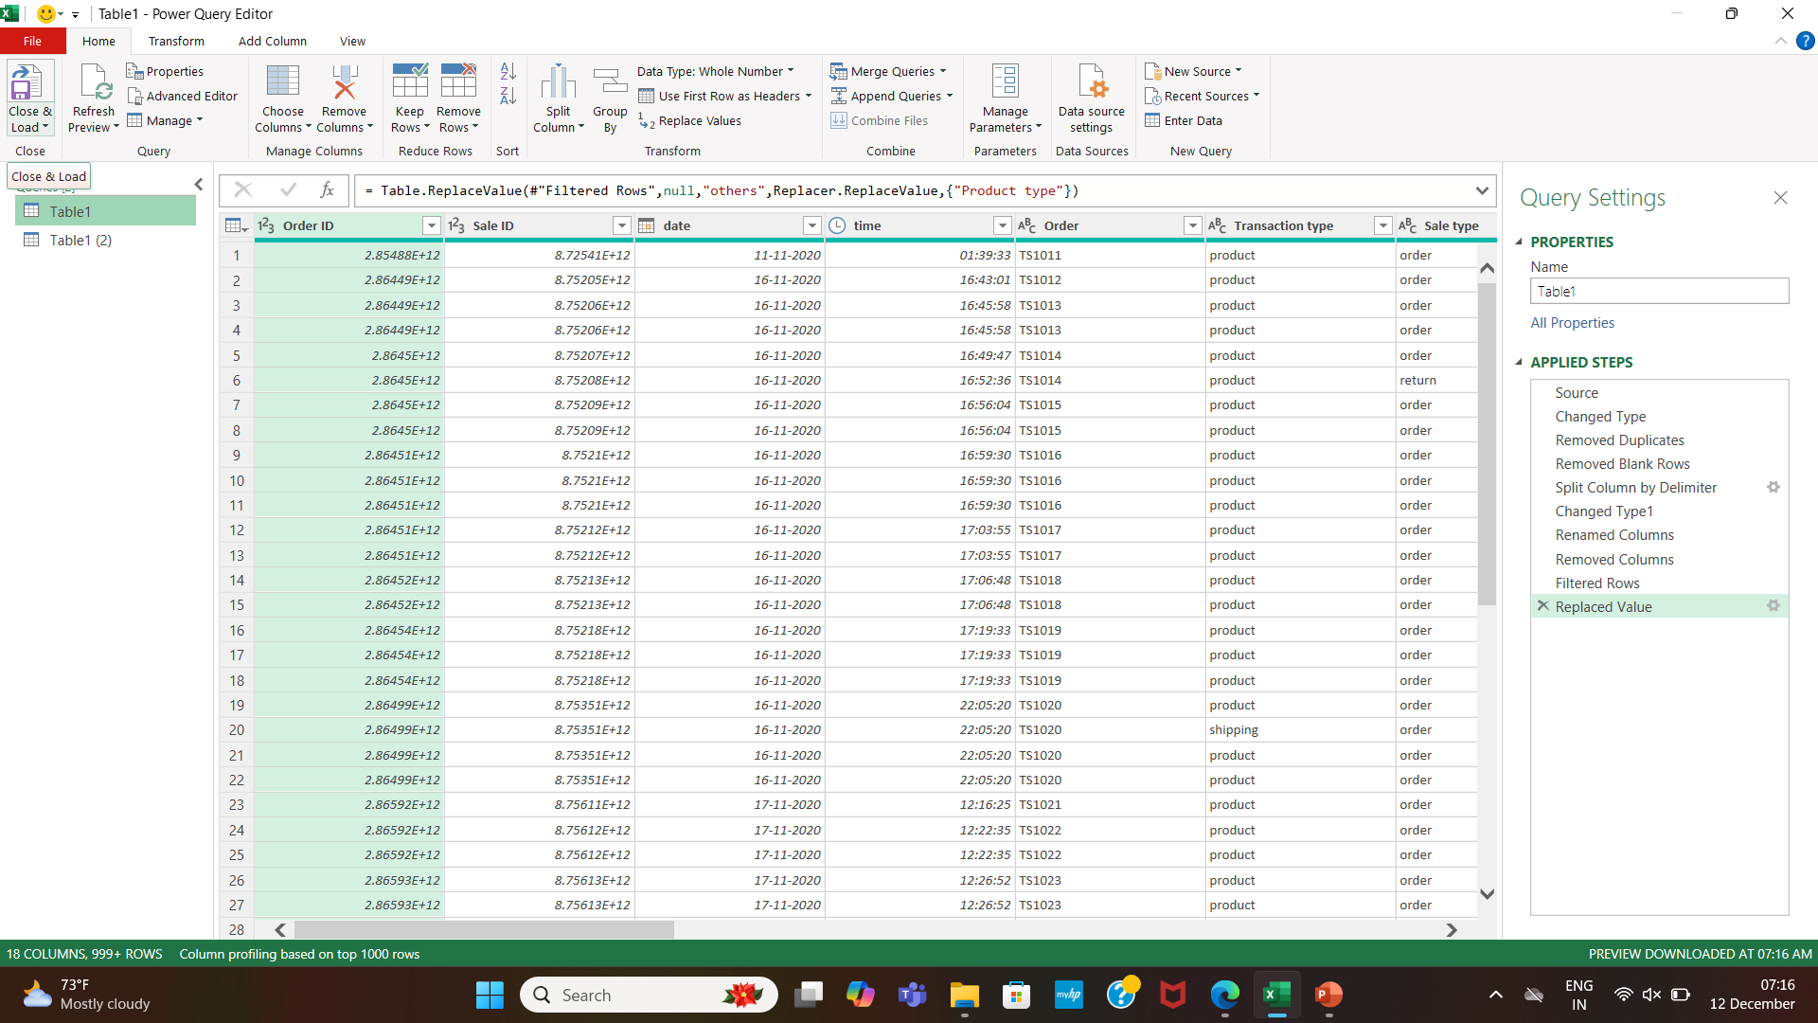
Data Set Overview
Data Cleaning
Removed Blank Rows, Duplicate Rows and Splited colums.
Cleaned Using Power Query

Slide 4
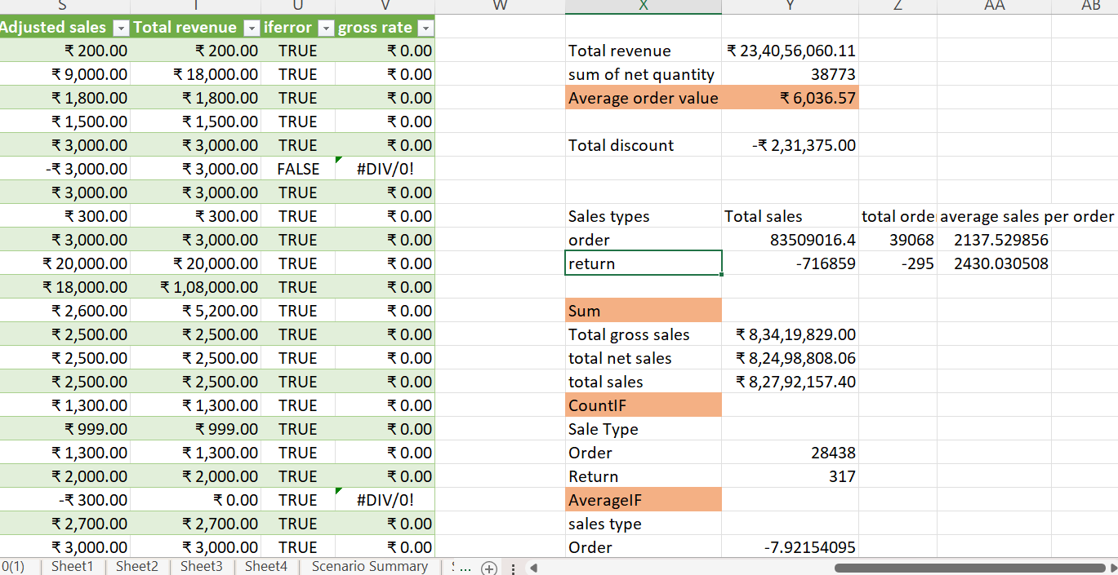
Important Calculations
Total sales (Gross, Net, Adjusted)
Average sales per order
Discount rates, return rates
Sales by channel/product type

Slide 5
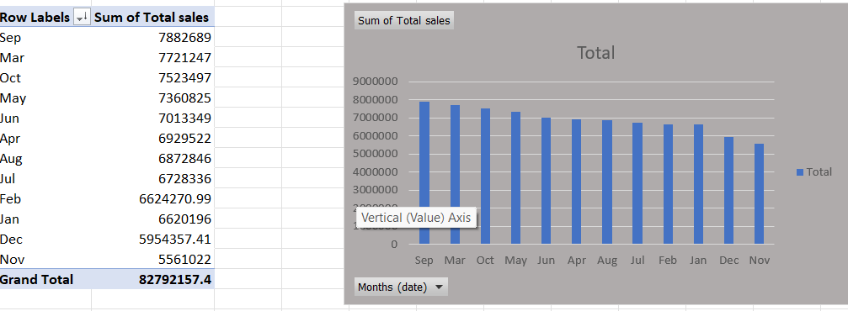
Pivot tables and charts

Slide 6
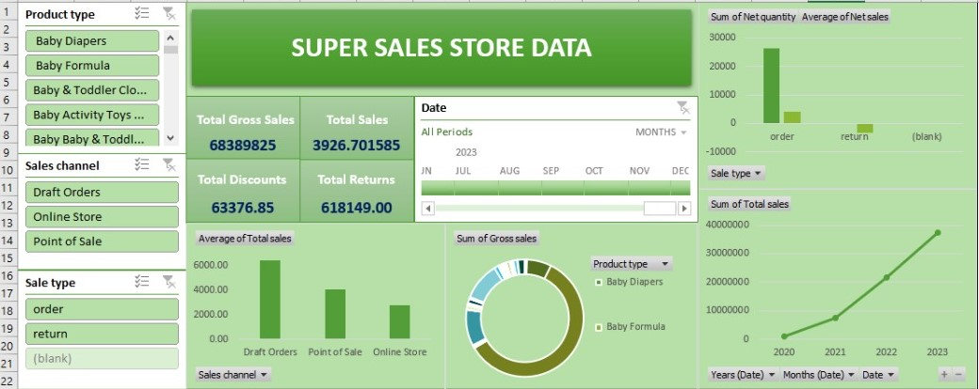
Dashboard

Slide 7
